Slide 1
QUantifying the Impact of Chronic pain on engagement in paid work (QUICK)
Stuart Anderson
Centre Manager, Centre for Musculoskeletal Health and Work (CMHW)

Slide 2
Background
Existing questionnaires that measure pain and work:
Often focus on productivity measures such as sickness absence or lost productivity while at work
Don’t focus on impact of pain on work itself, or how the individual is affected
However, chronic pain affects people’s work in a variety of ways

Slide 3
QUICK Aim & Study Design
Aim: To develop a new questionnaire that can be used to assess the different ways chronic pain affects work.
LITERATURE REVIEW
FOCUS GROUPS
DRAFTING THE INSTRUMENT
REFINING (DELPHI)
TESTING (SURVEY AND EVALUATION)
Stage 1
Stage 2
Stage 3
Stage 4
Stage 5

Slide 4
Stage 1: Literature Review
Quantitative studies
(n = 46)
Existing questionnaires
Narrow range of impacts
Pain as cost to employer
Qualitative studies
(n = 16)
Interview studies
Describe much broader ways in which pain impacts individuals’ ability to engage in work

Slide 5
Stage 2: Focus Groups
13 online sessions
50 participants
6 with people with pain
4 with stakeholders
3 interviews
32 people with pain
18 stakeholders

Slide 6
Stage 2: Focus Groups
Job modifications & relationship with line manager
Job modifications & relationship with line manager
Hidden disability
Disclosure
Being believed
Cognitive issues (inc. fatigue)
Commuting
Fluctuating pain
Fluctuating pain
Medication
Beliefs
Personal economic consequences
Impacts outside of work
Personal economic consequences
Role changes
Good parts of work

Slide 7
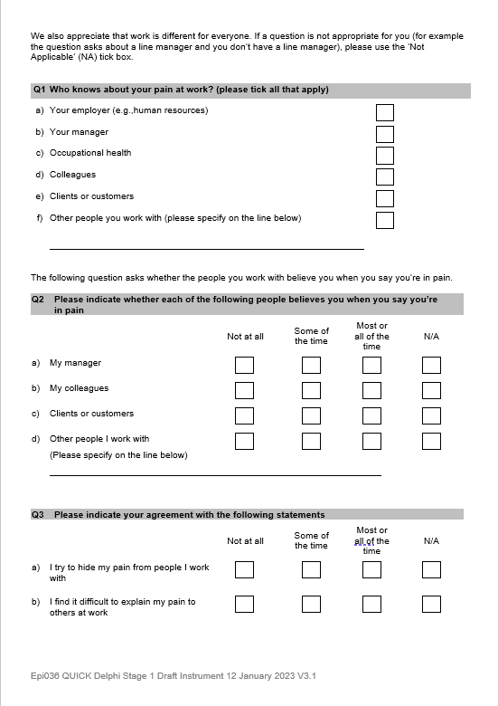
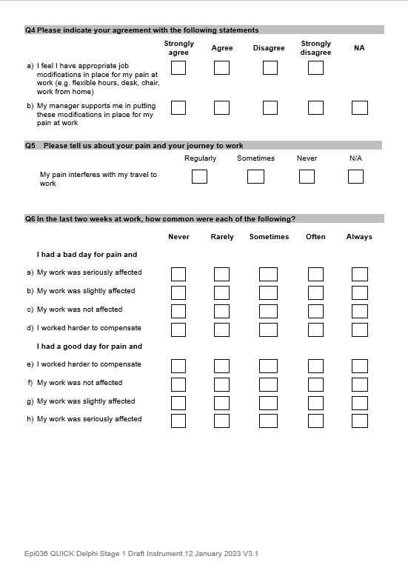
Stage 3: Drafting the Instrument

Slide 8
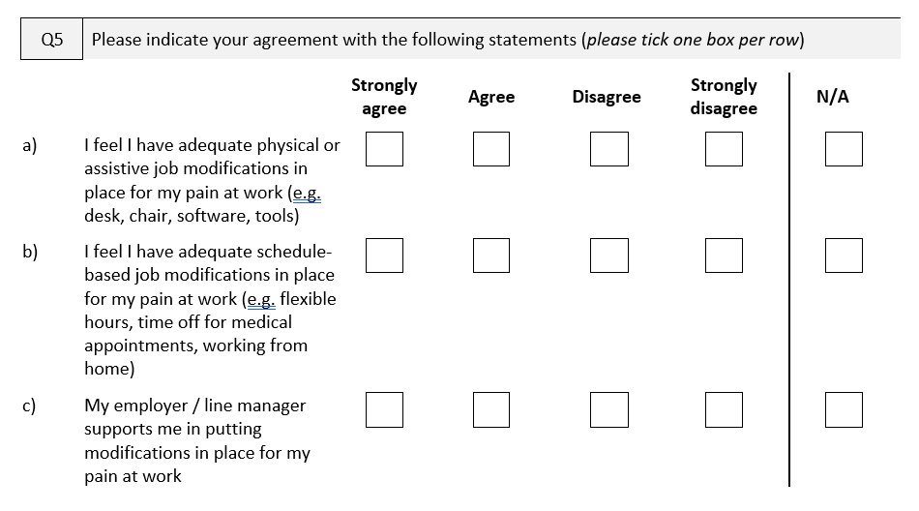
Stage 3: Drafting the Instrument

Slide 9
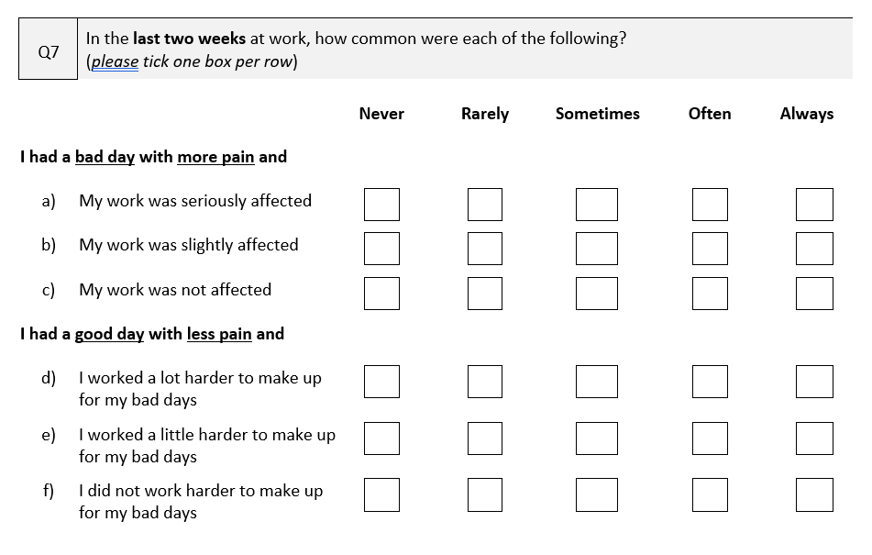
Stage 3: Drafting the Instrument

Slide 10
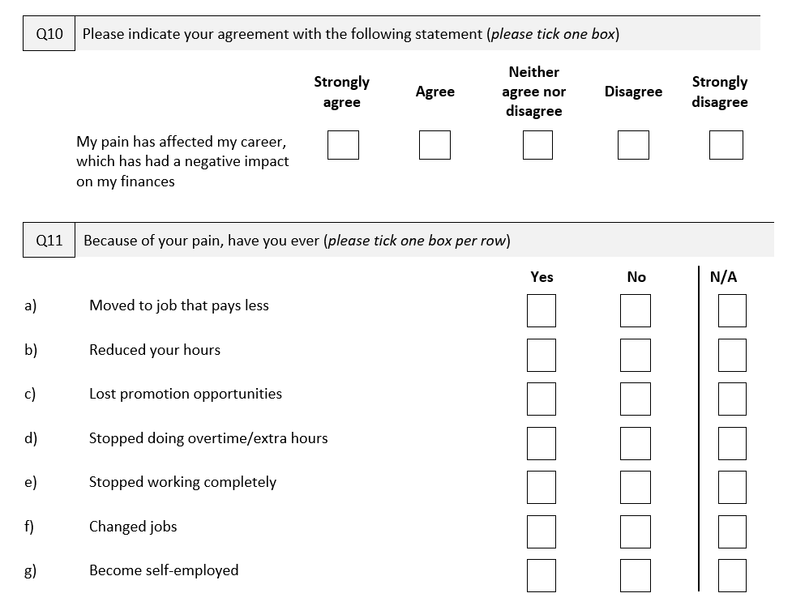
Stage 3: Drafting the Instrument

Slide 11
Stage 4: Refining the Questionnaire
Focus Groups
Voting
Amended
Amended
… some minor amendments based on free-text comments
Online Survey
Amended
Amended

Slide 12
Stage 5: Testing the Questionnaire
LITERATURE REVIEW
FOCUS GROUPS
DRAFTING THE INSTRUMENT
REFINING (DELPHI)
TESTING (SURVEY AND EVALUATION)
We are here

Slide 13
Stage 5: Evaluating the Questionnaire
Online survey
Test-retest
Think Aloud

Slide 14
What’s next?
When will the questionnaire be ready?
Spring 2024
Who is it for?
Academics
Clinicians
Employers
Human resources
Occupational health providers

Slide 15
Our team

